Slide 1

Mid-Semester Report:
Remodelling and Unit Loss in Boston
TEAM - A

Slide 2
FOR TODAY
Review how housing is changing amongst different communities
Where are housing remodels and renovations happening?
How many housing units are lost to remodels on average, each year?

Slide 3

REVIEW OF PREVIOUS FINDINGS
Found Unit changes by Community: significant increase in units in areas like South Boston, Central Boston and Dorchester. Concerning decrease in Mattapan (due to possible zip codes transfer between Mattapan and Hyde Park).
Initial Observation for Permit Trends: clear upward trends in prioritizing safety improvements. Roxbury, Dorchester, South Boston, East Boston being areas with significant renovation changes.
Patterns in Land Use: decreasing trend in multi-family(R4) units with simultaneous increasing single-family(R1) units
Notes:
R1/R4 trend, our report mentions specifically 02108, 02115, and 02116

Slide 4
WHERE ARE HOUSING REMODELS AND RENOVATIONS HAPPENING?

Slide 5
DATA CLEANING
Extract data related to “issued_date”, “zip”, and “worktype”
Drop any rows that “zip”, “worktype”, “issued_date” is missing
Convert “issued_date” to date time format and extract “year”
Convert “zip” column to 5-digit format, match and assign zip codes to corresponding community
Consolidate “worktype” column into broader categories, store in new column “worktype_category” for further analysis
Notes:
Where are housing remodels and renovations happening?
Mention that 2008 data is missing
For stats, we’ll be excluding data from 2006-2009 and 2024, 2006-2009 seems to be documented incompletely (huge gap in amount compare to 2010), 2024 (not finished yet, so exclude)

Slide 6
Renovations from ‘worktype’
After recategorizing the ‘worktype’ field in the dataset, we branched the following work types under an umbrella term ‘renovation’ :
Interior/Exterior Work
Renovations - Exterior
Renovations - Interior NSC
Insulation
Siding
Installation of Decorative Mat
Installation of Floor Covering
Installation of InteriorFinish
Installation/Evaluation of Mat
This recategorized worktype field has been used for the following graphs and analysis on renovations happening around boston over the years
Notes:
Just for reference

Slide 7
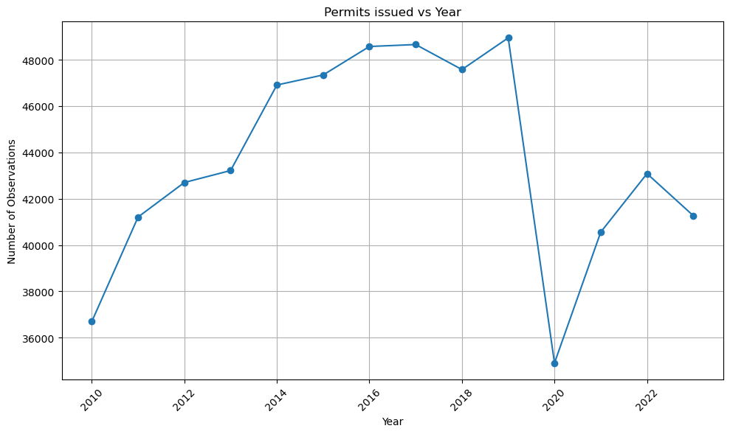
Permits Issued VS. Year
Excluding 2006-2009, and 2024:
2019 has the maximum permits which is: 48867 permits
2020 has the minimum permits which is: 34837 permits
Percentage Change:
2019-2020 has the minimum percentage growth which is: -28.71%
2020-2021 has the maximum percentage growth which is: 16.29%
Notes:
Just for reference: Number of permits issued each year:
For year 2006, 1 permits were issued.
For year 2007, 1 permits were issued.
For year 2009, 973 permits were issued.
For year 2010, 35339 permits were issued.
For year 2011, 39808 permits were issued.
For year 2012, 41647 permits were issued.
For year 2013, 42837 permits were issued.
For year 2014, 46720 permits were issued.
For year 2015, 47222 permits were issued.
For year 2016, 48471 permits were issued.
For year 2017, 48560 permits were issued.
For year 2018, 47506 permits were issued.
For year 2019, 48867 permits were issued.
For year 2020, 34837 permits were issued.
For year 2021, 40512 permits were issued.
For year 2022, 43029 permits were issued.
For year 2023, 41224 permits were issued.
For year 2024, 5043 permits were issued.
Percentage growth each year:
From 2006 to 2007: 0.00%
From 2009 to 2010: 3531.96%
From 2010 to 2011: 12.65%
From 2011 to 2012: 4.62%
From 2012 to 2013: 2.86%
From 2013 to 2014: 9.06%
From 2014 to 2015: 1.07%
From 2015 to 2016: 2.64%
From 2016 to 2017: 0.18%
From 2017 to 2018: -2.17%
From 2018 to 2019: 2.86%
From 2019 to 2020: -28.71%
From 2020 to 2021: 16.29%
From 2021 to 2022: 6.21%
From 2022 to 2023: -4.19%

Slide 8
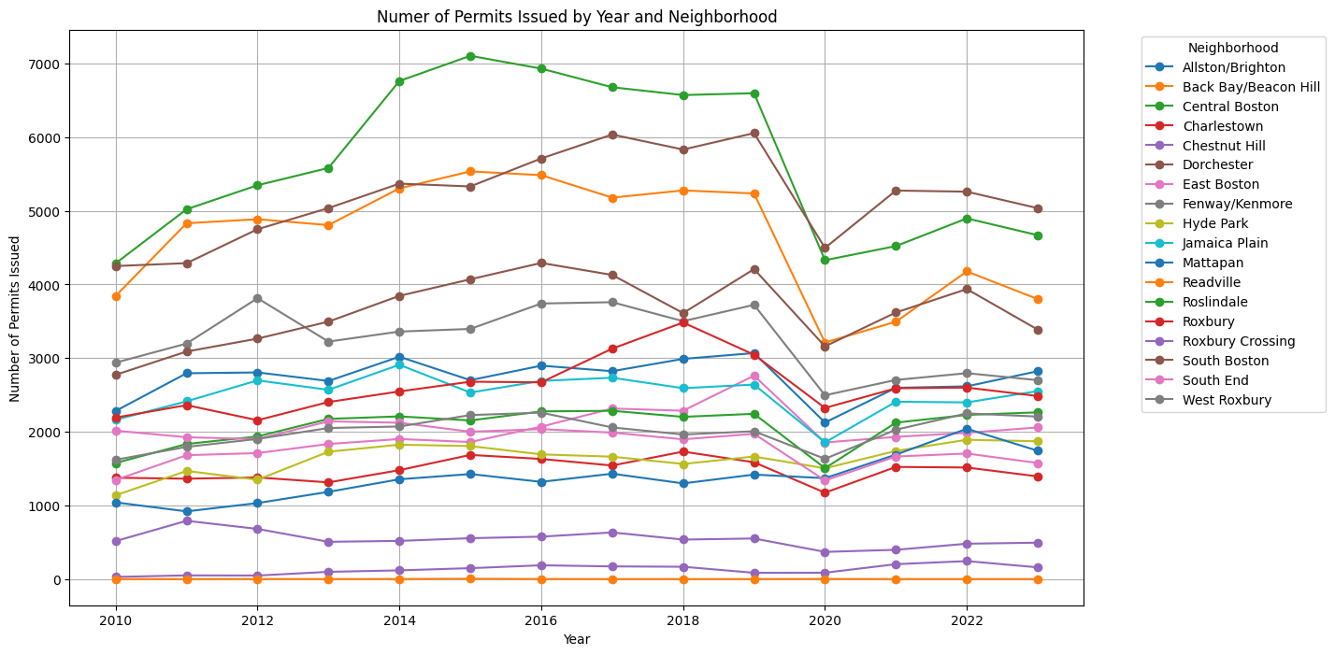
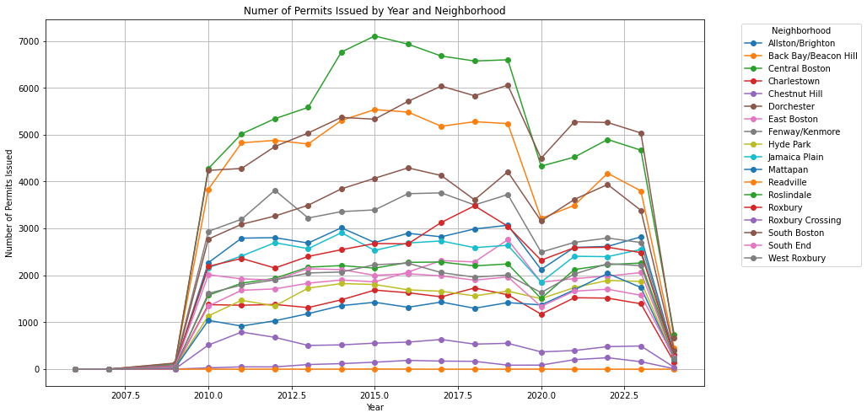
Number of permits (yearly) for each community
Top 3 communities with the most permits issued:
Central Boston
Dorchester
Back Bay/Beacon Hill
Communities with the least permits issued:
Readville
Newton (No Data Found)
Dedham (No Data Found)
Notes:
For year 2019:
Top 3 neighborhoods with most permits:
Central Boston: 6598 permits
Dorchester: 6056 permits
Back Bay/Beacon Hill: 5237 permits
Neighborhood with fewest permits: Chestnut Hill (85 permits)
For year 2020:
Top 3 neighborhoods with most permits:
Dorchester: 4497 permits
Central Boston: 4330 permits
Back Bay/Beacon Hill: 3212 permits
Neighborhood with fewest permits: Readville (2 permits)
This and the following graphs do not have any data points for 2006, 2007, 2008, 2009 and 2024 as the data available is extremely limited and insignificant

Slide 9
Noticeable Findings
From 2010-2018, Central Boston is always on the top 1 position with most permits
Starting from 2019, Dorchester becomes the top 1 community with the most permits
Other than 2021, Central Boston, Dorchester, and Back Bay/Beacon Hill are always the top 3 communities with the most permits
2021: sudden increase in South Boston (3620 permits), suppressing Back Bay/Beacon Hill area

Slide 10
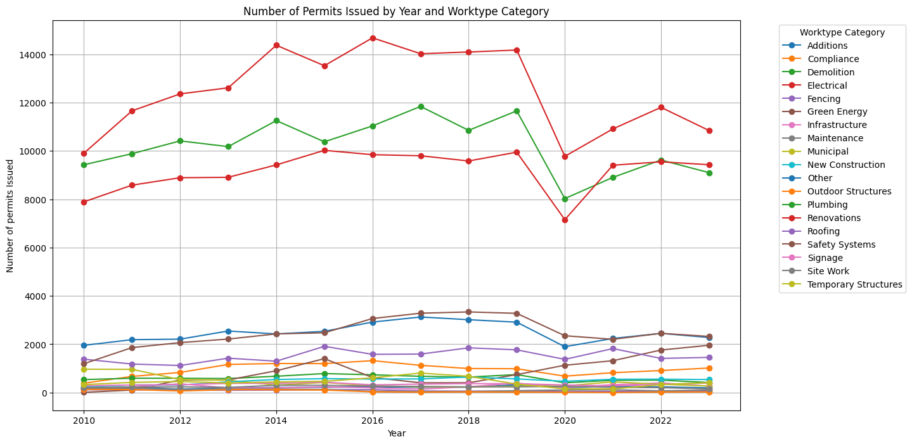
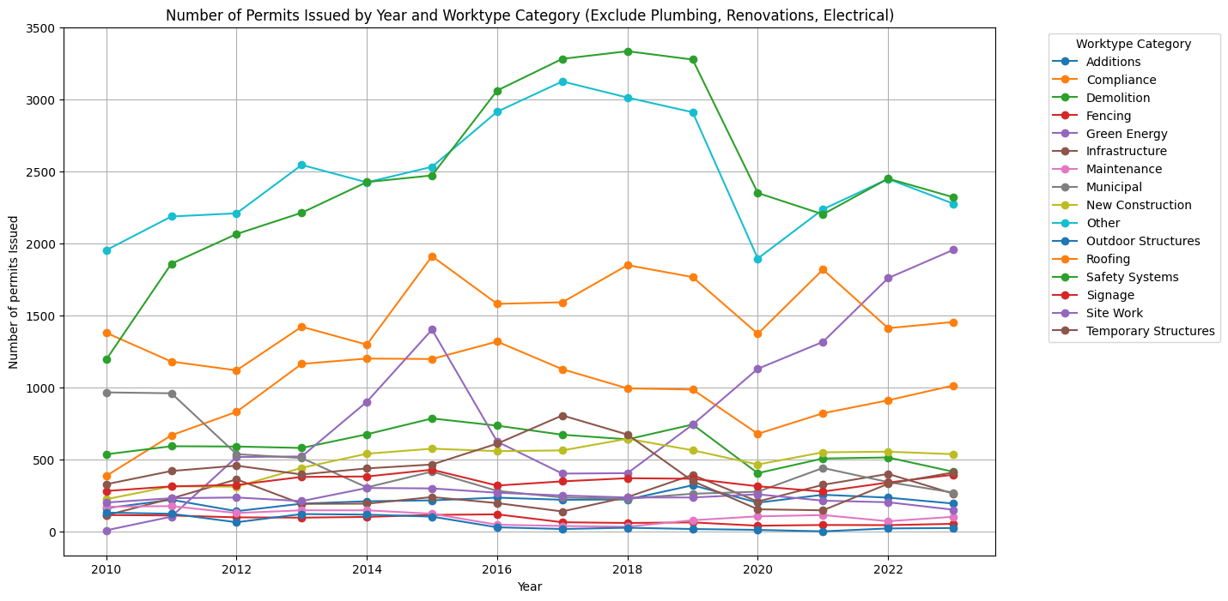
Number of permits (yearly) for each worktype category
Notes:
Top 3 are: Plumbing, renovations, electrical (upper graph)
Top 3 (bottom): Safety Systems, Other, Roofing

Slide 11
Noticeable Findings
Top 3 Worktype Categories (2010-2023):
Electrical: 174,688 total, 12,478 permits/year
Plumbing: 142,532 total, 10,181 permits/year
Renovations: 128,415 total, 9173 permits/year
2021, 2023 are the only two years where “Renovations” suppress “Plumbing” to be the second highest in number
Worktype categories with fewest permits (2010-2023)
Outdoor Structures (2012, 2015-2023)
Fencing (2013-2014)
Green Energy (2010-2011)

Slide 12
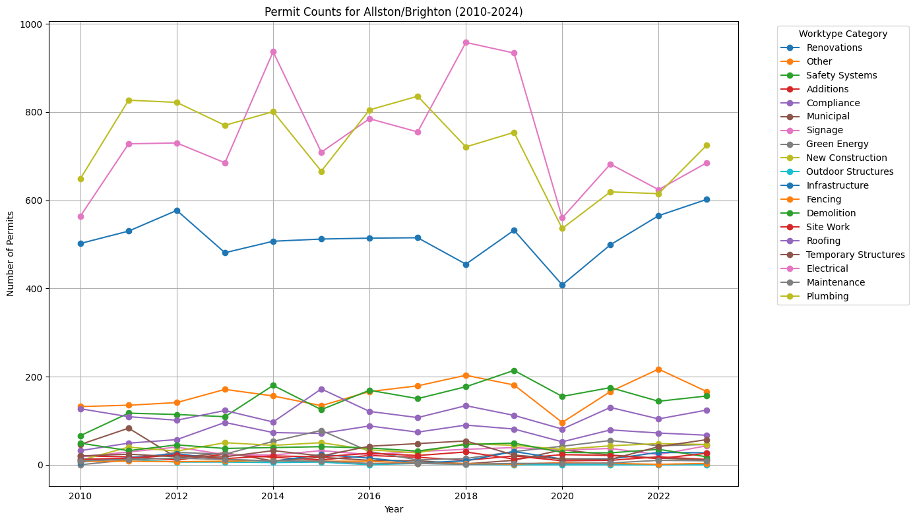
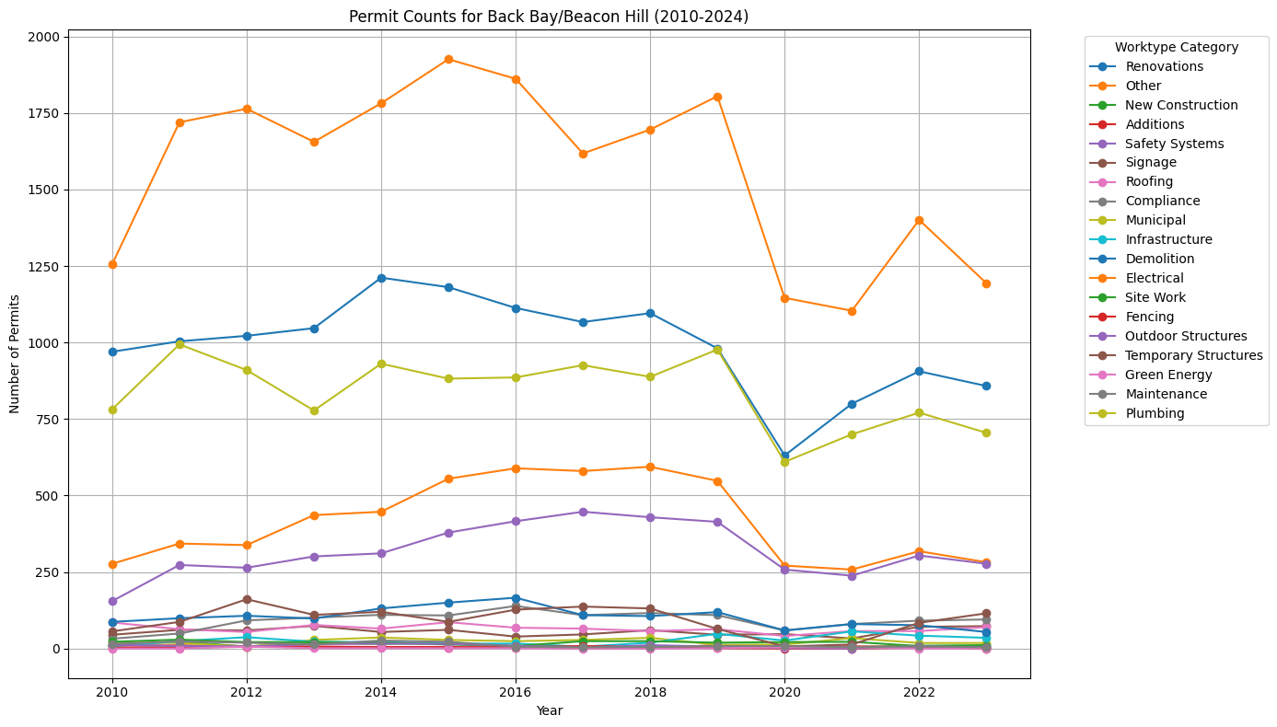
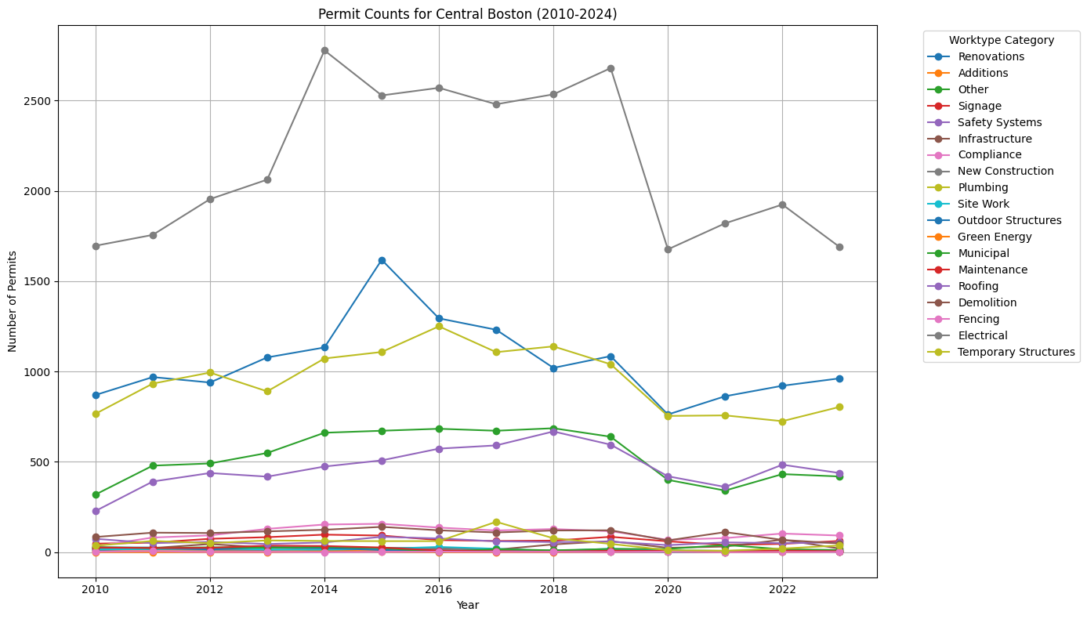
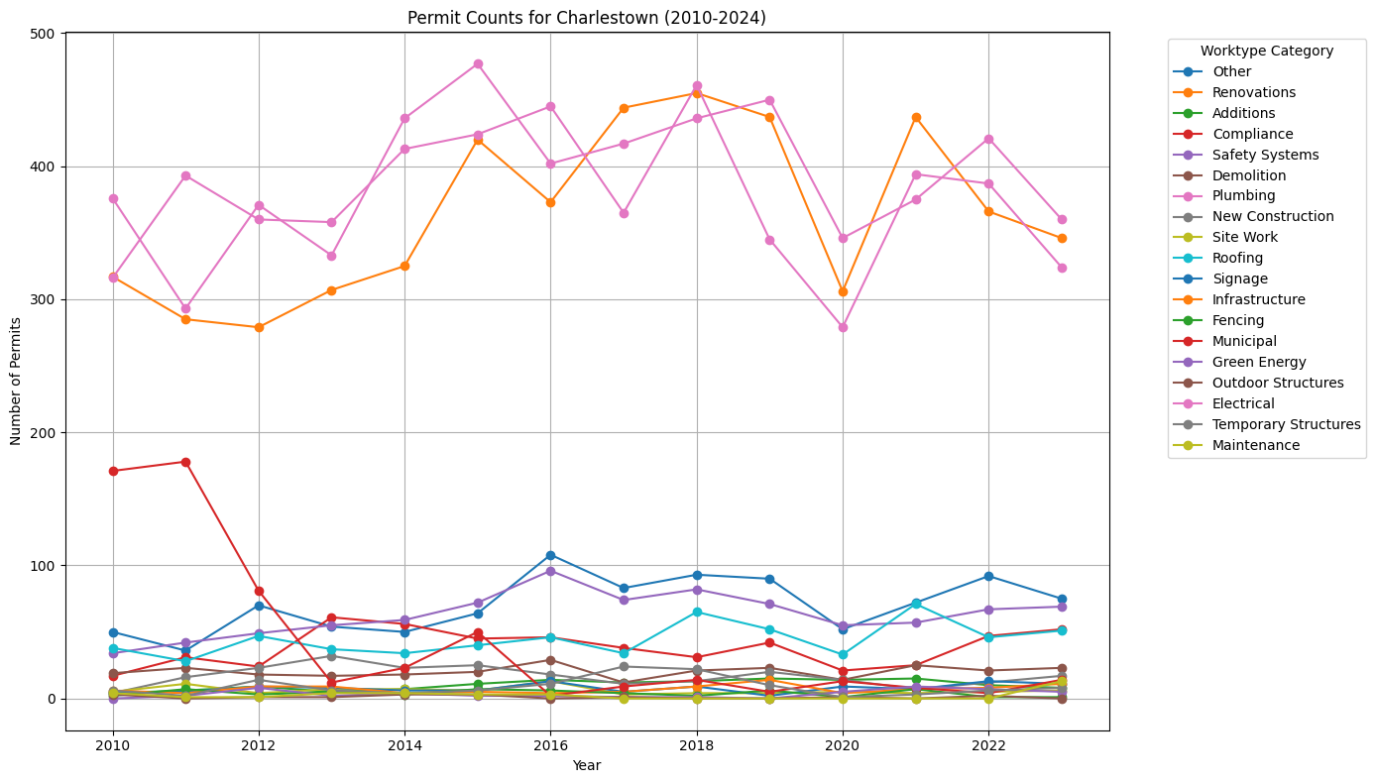
Allston
/Brighton
Back Bay/
Beacon Hill
Electrical
Plumbing
Renovations
Electrical
Renovations
Plumbing
Central Boston
Charlestown
Electrical
Plumbing
Renovations
Electrical
Renovations
Plumbing

Slide 13
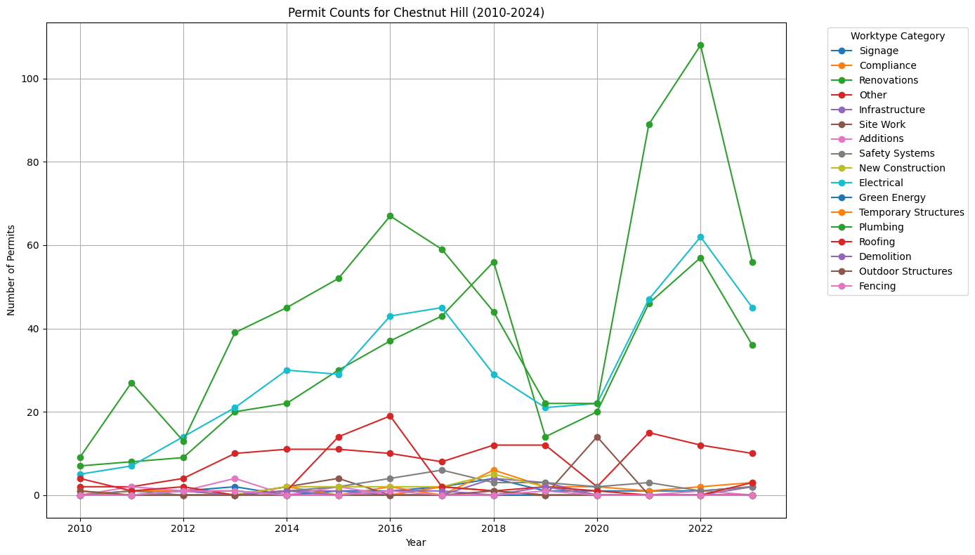
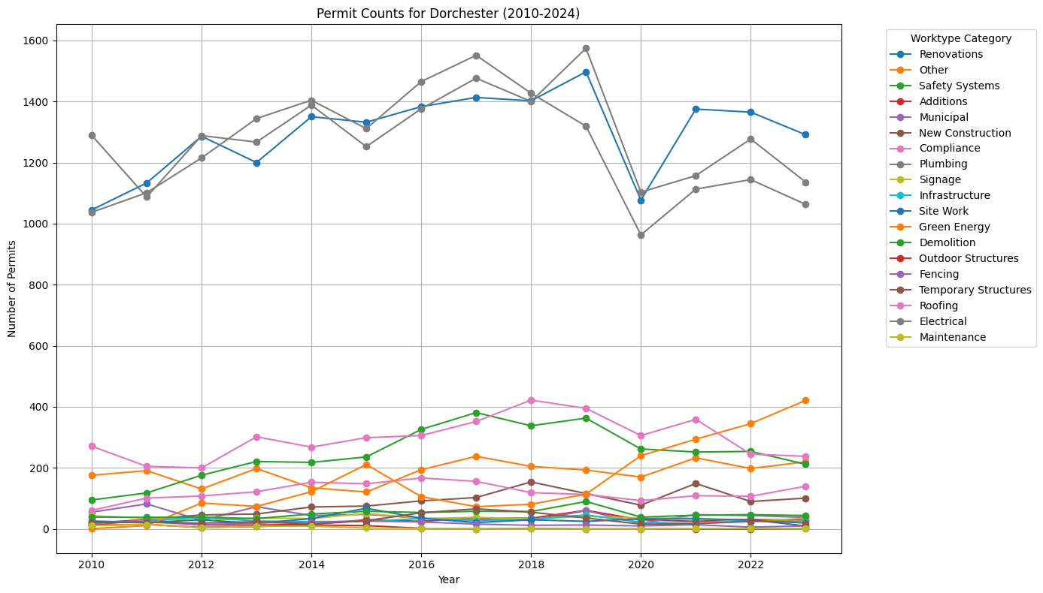
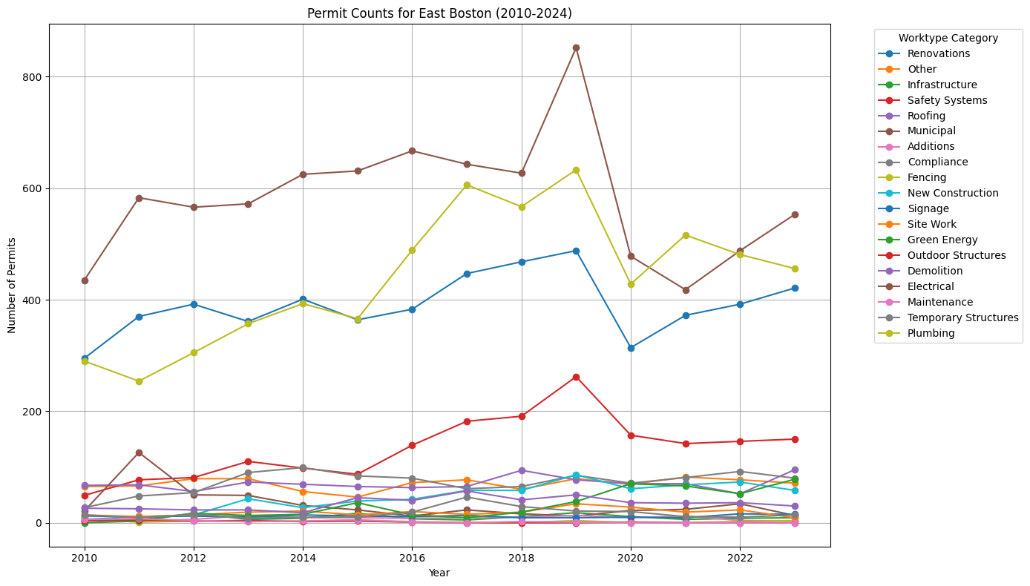
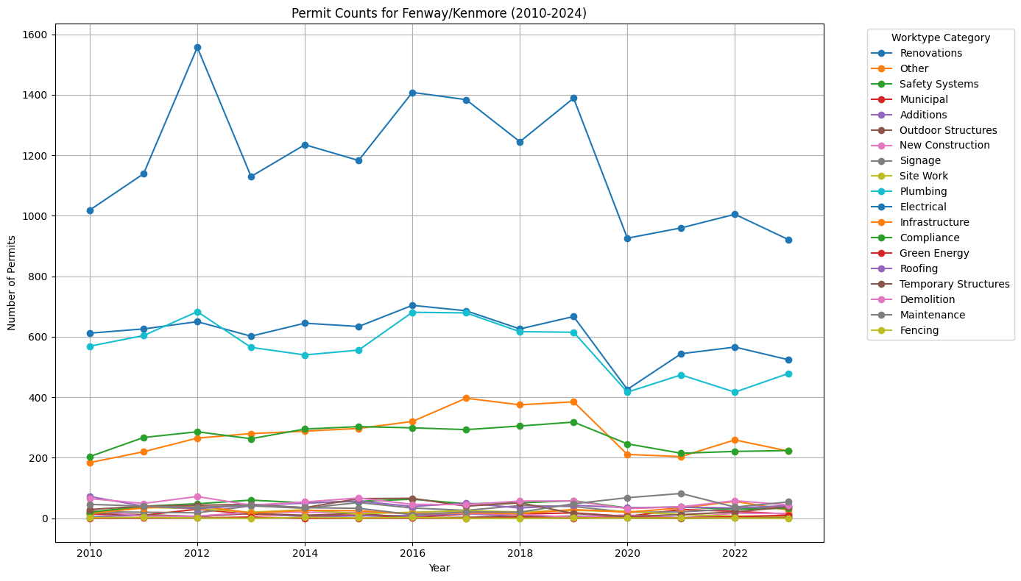
Permit Counts Changes for each Worktype Category (by Community)
Chestnut Hill
Dorchester
Plumbing
Renovations
Electrical
Electrical
Plumbing
Renovations
East Boston
Fenway
/Kenmore
Electrical
Plumbing
Renovations
Electrical
Renovations
Plumbing

Slide 14
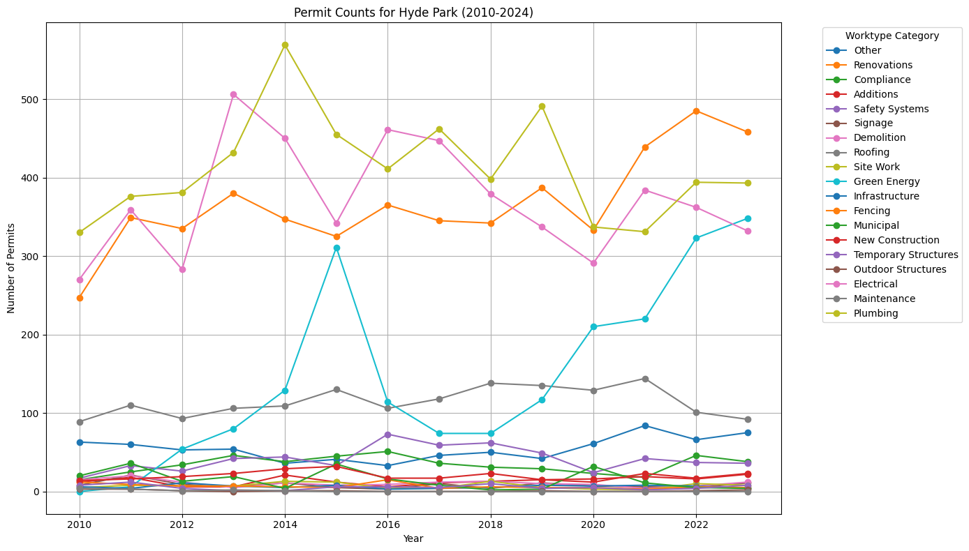
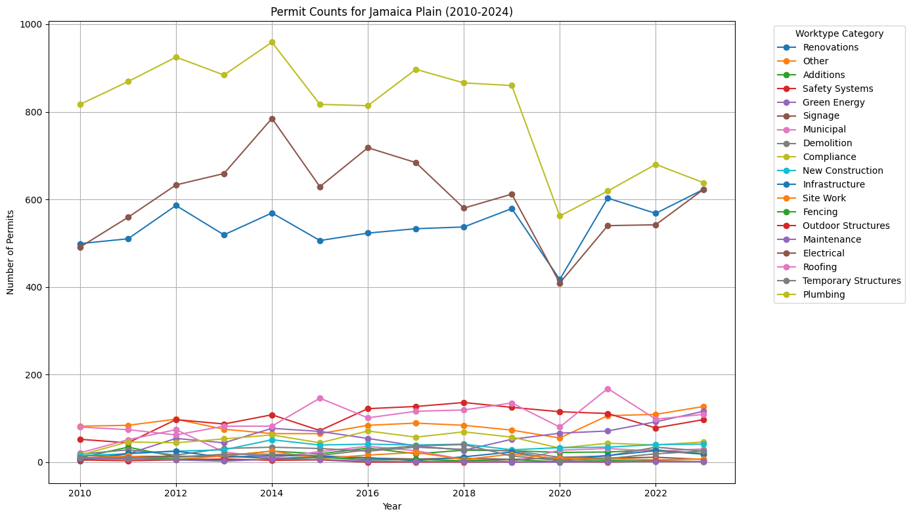
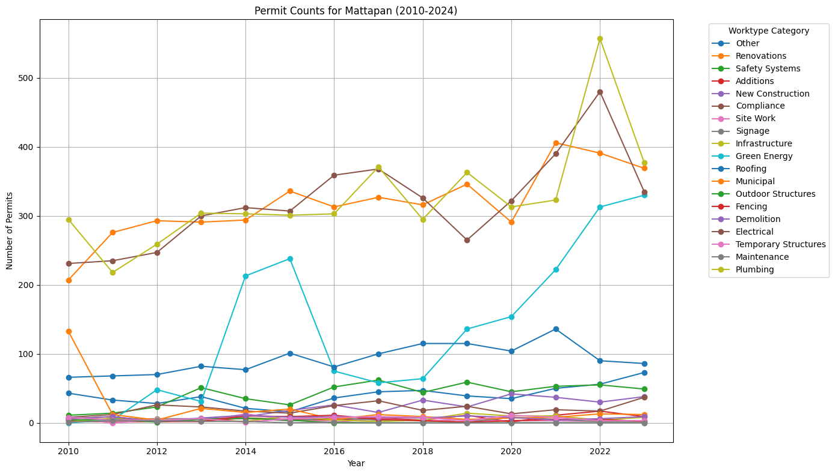
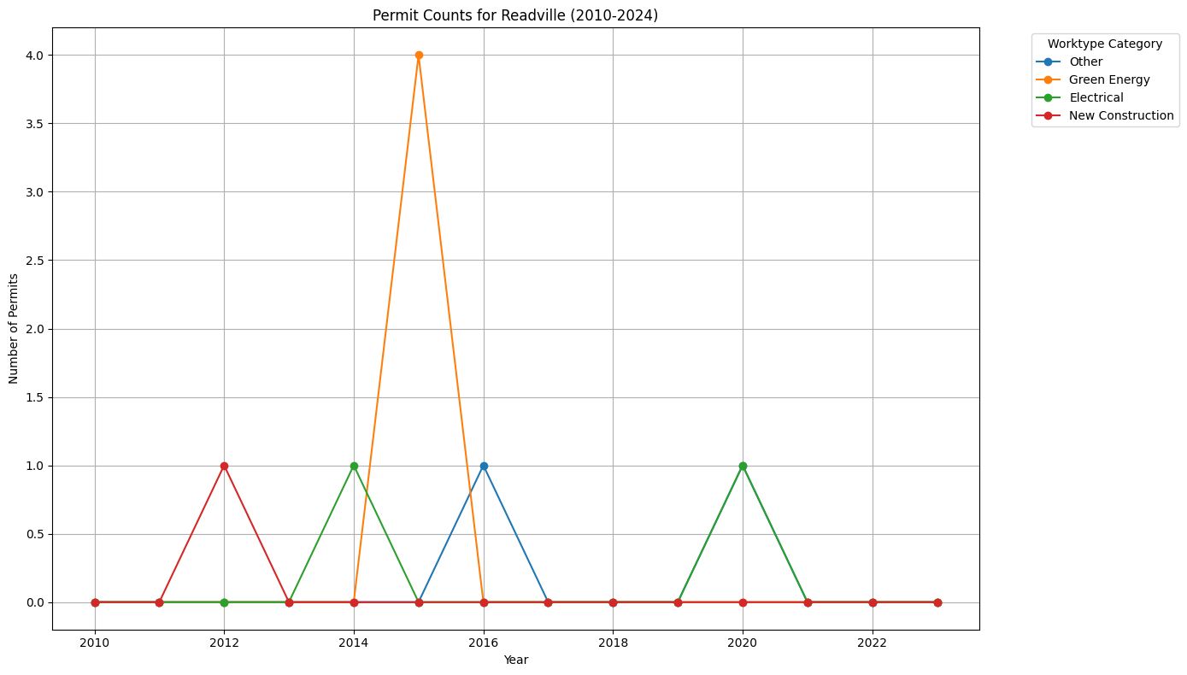
Permit Counts Changes for each Worktype Category (by Community)
Hyde Park
Jamaica Plain
Plumbing
Renovations
Electrical
Plumbing
Electrical
Renovations
Readville
Green Energy
Electrical
Other
Mattapan
Plumbing
Electrical
Renovations

Slide 15
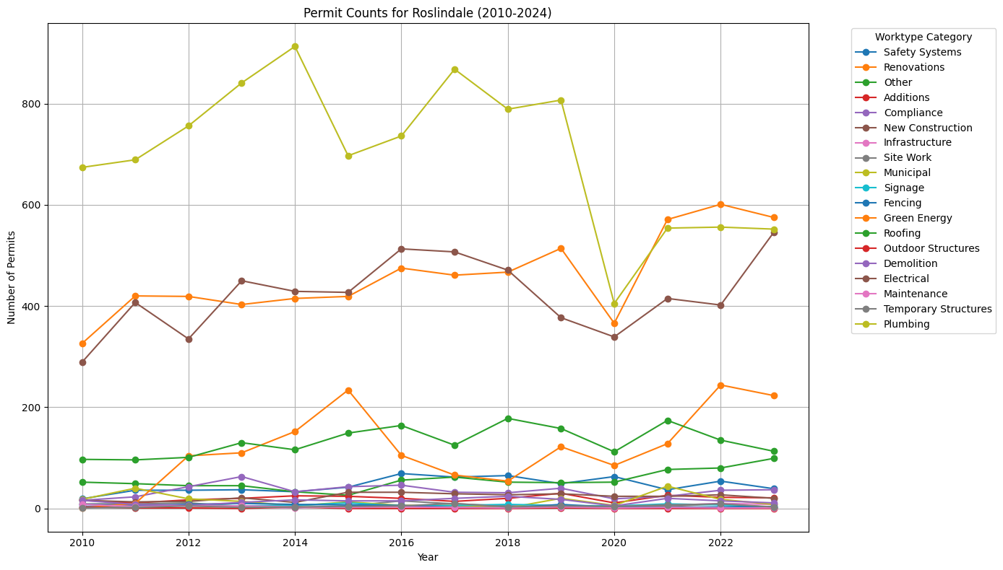
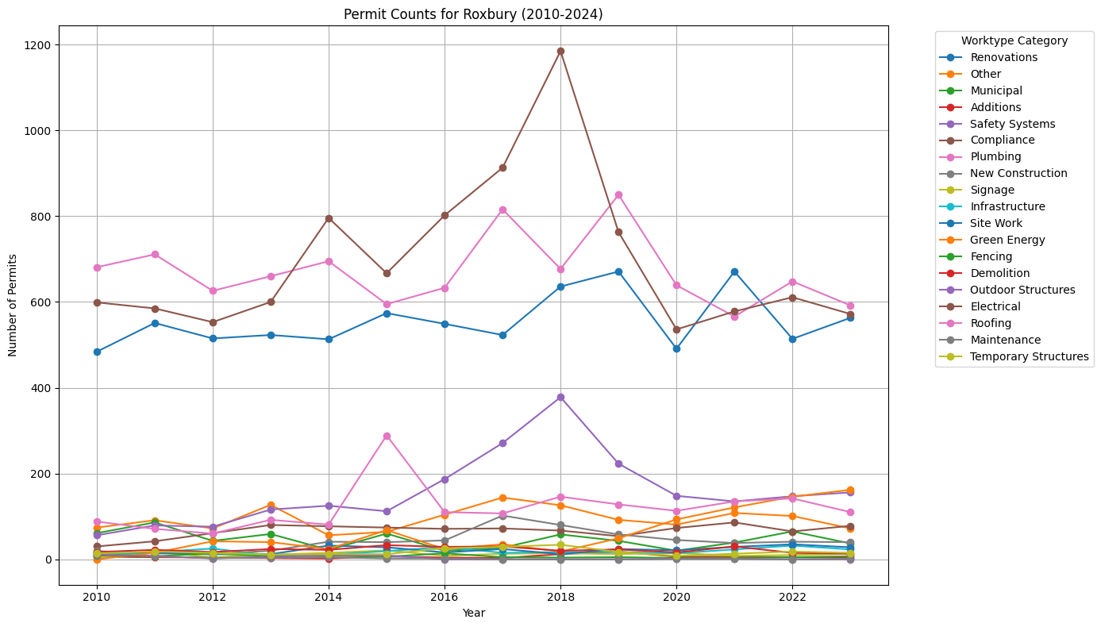
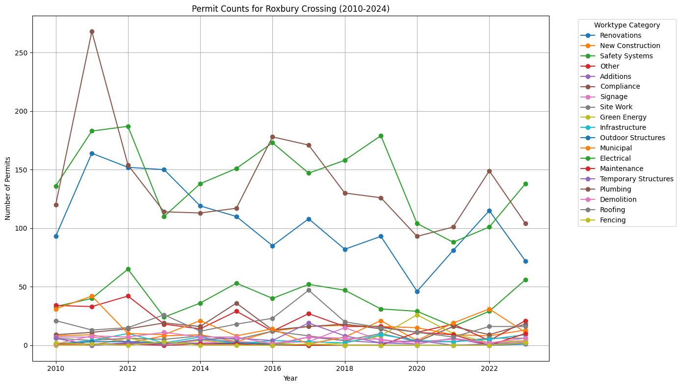
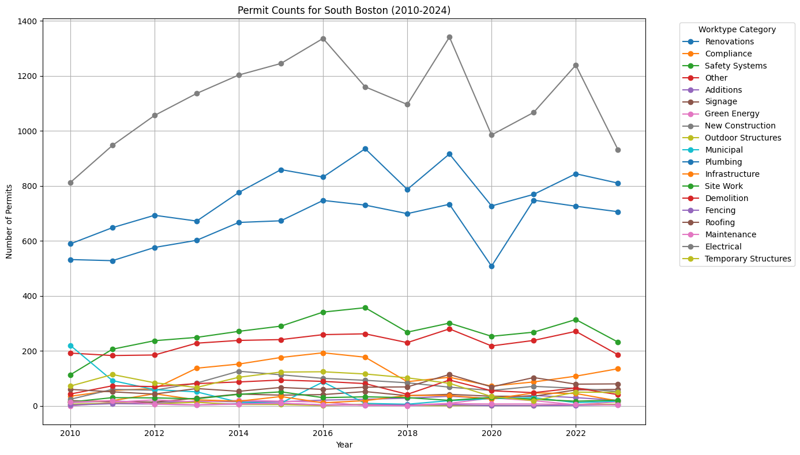
Permit Counts Changes for each Worktype Category (by Community)
Roslindale
Plumbing
Electrical
Renovations
Roxbury
Electrical
Plumbing
Renovations
Roxbury Crossing
South Boston
Plumbing
Electrical
Renovations
Electrical
Plumbing
Renovations

Slide 16
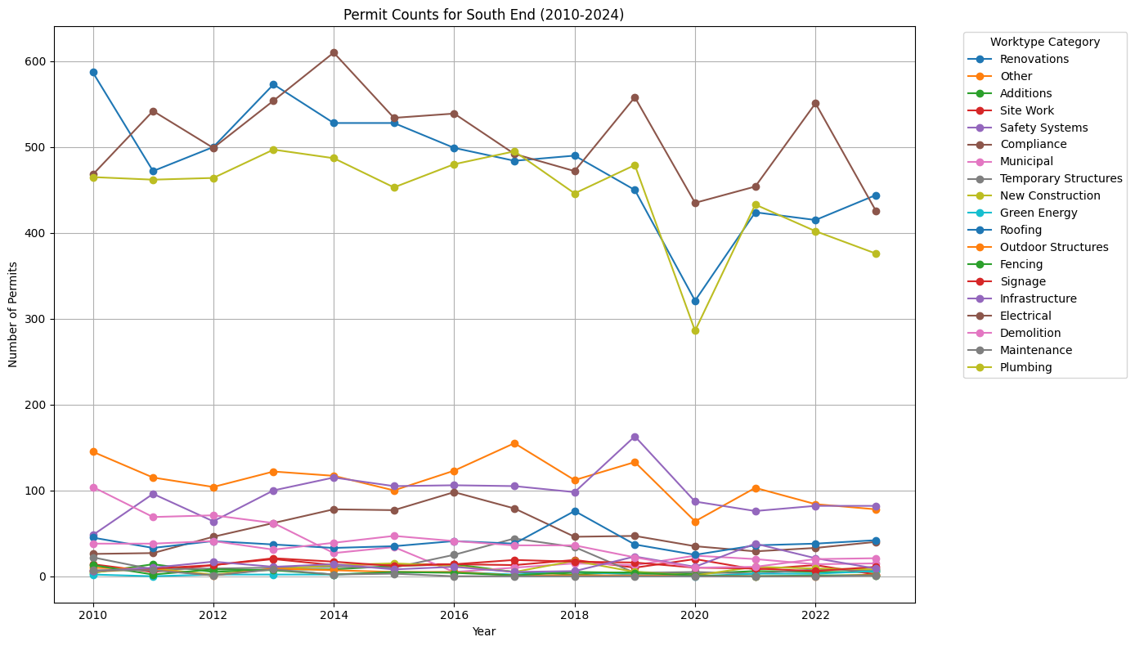
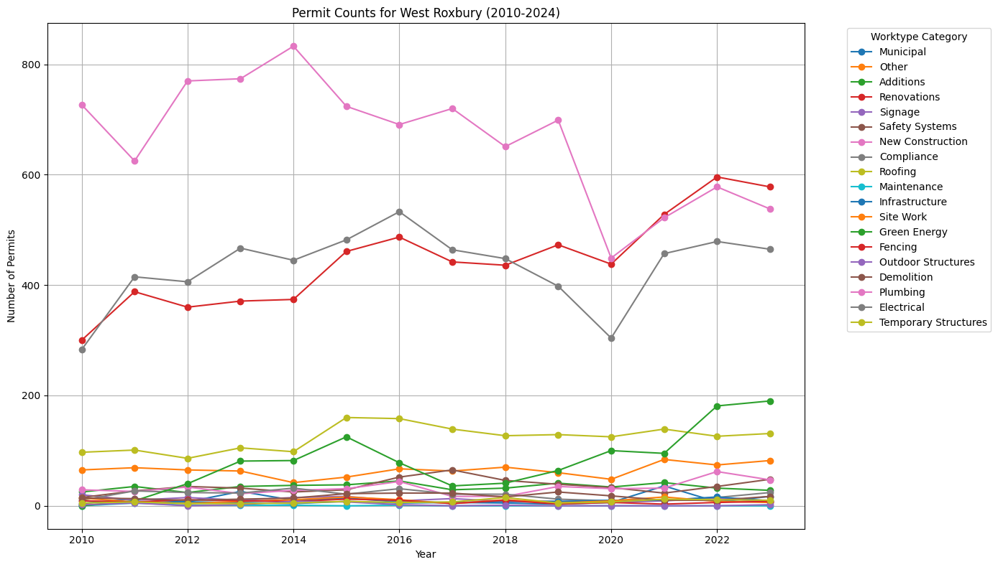
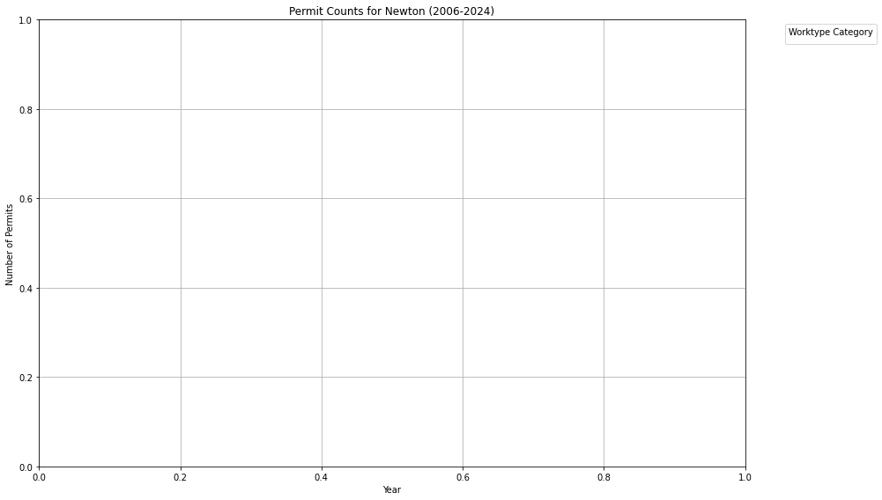

South End
West
Roxbury
Electrical
Renovations
Plumbing
Plumbing
Electrical
Renovations
Newton
(No Data)
Dedham
(No Data)

Slide 17
Noticeable Findings
General Decrease in 2020
Possible Reason: Covid Pandemic
Other than Electrical, Plumbing, and Renovations, these categories are also popular:
Safety System
Roofing
Green Energy (typically Hyde Park, Mattpan, Roslindale, Dorchester)
Other
Notes:
Building permit approvals during covid slowed down

Slide 18
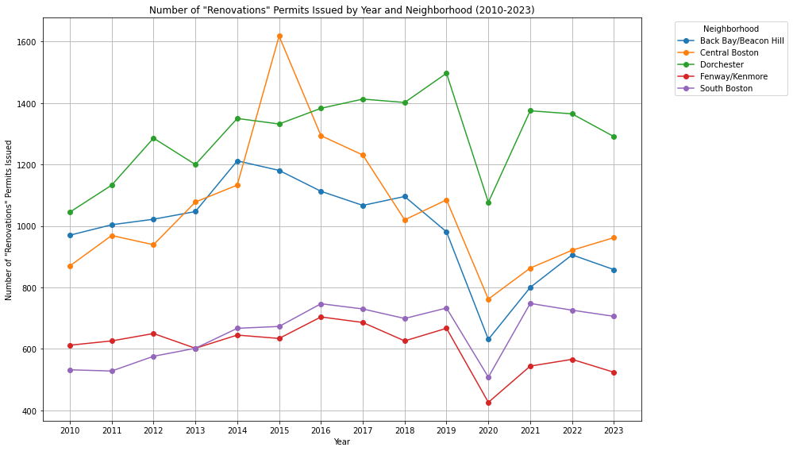
Where renovations are happening
Top 3 neighborhoods with most “Renovations” worktype category are Dorchester, Central Boston, and Back Bay/Beacon Hill

Slide 19
Questions left to search
Significant increase of demand for green energy around 2014-2015, 2019-2023 in Hyde Park and Mattapan
Notes:
Might need to search for the reasons? (also for the next slide)

Slide 20
Questions left to search
Sudden increase in Municipal work type around 2010-2012 for Charlestown and East Boston
Significant increase in working permits for multiple work types in 2019 for East Boston

Slide 21
HOW MANY HOUSING UNITS ARE LOST TO REMODELS ON AVERAGE, EACH YEAR?

Slide 22
DATA CLEANING - Q4
Using feature “PID” (unique number for each property), “LU” (Land Use)
Renamed all the parcel ID to “PID” for consistency, eliminate all special characters that appears in this column and keeping just the 10-digit number
Filter out any rows with invalid entry for “LU” column
Notes:
If you guys have any better solution to this question, u guys can correct me. Here’s how I did with the data:
Ideally, it might be easier to use the “YR_REMODEL” column to find out the year that the property is remodeled and collect data (especially “RES_UNITS” (number of residential units) or “LOT_SIZE” (lot size of the property)) to determine whether a multi-family property is remodeled to multiple single-family units
The problem is that 2004-2007 dataset does not contain any similar column for “YR_REMODEL” and “RES_UNITS”
So, the alternative solution is to compare the PIDs between two consecutive years, the ones that appear in the previous year but not the later year is considered as lost units; the ones that appear in the later year but not the previous year is considered as newly-built units

Slide 23
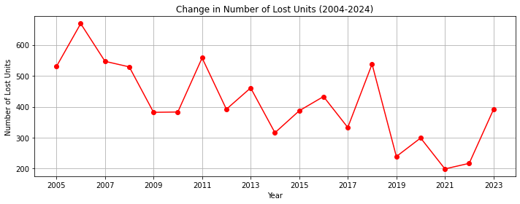
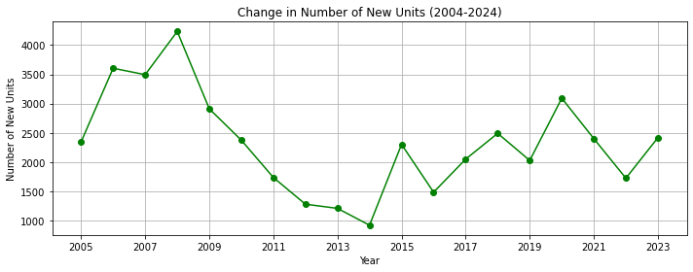
Changes in Number of Lost/New Units (2004-2024)
From 2005-2006, we have the maximum number of lost units (669 units)
From 2020-2021, we have the minimum number of lost units (199 units)
From 2007-2008, we have the maximum number of new units (4233 units)
From 2013-2014, we have the minimum number of new units (920 units)
Notes:
Average housing units lost per year: 411 units

Slide 24
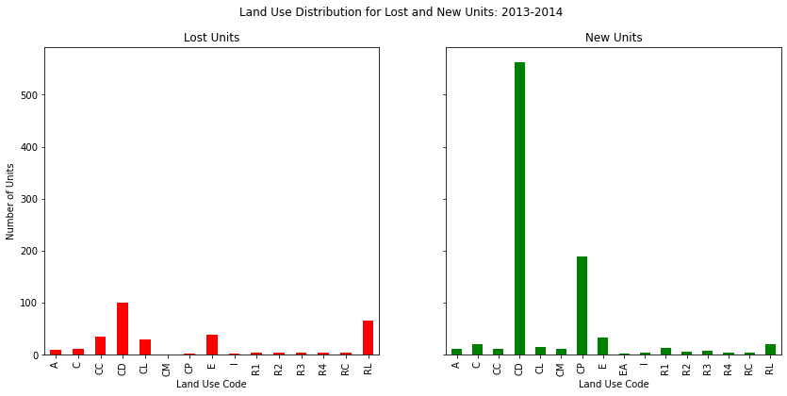
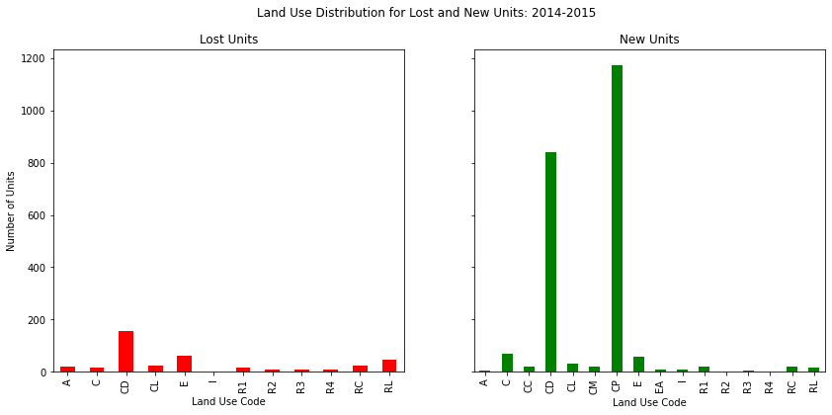
Noticeable Findings
Among the new units, the type CD (Residential Condominimum Unit) and CP (Condo Parking) are the highest in number
Among the lost units, the type CD, CL (Commerical Land), and E (Tax-exempt) are the highest in number
Notes:
Upper graph: 2013-2014
Bottom graph: 2014-2015 (only year where CP suppresses CD in new units)

Slide 25
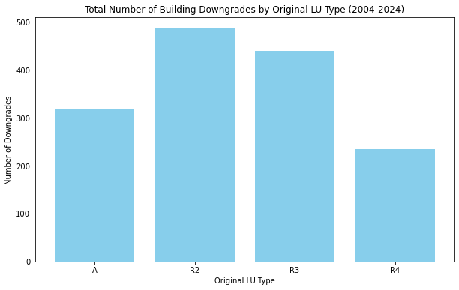
Focus on type A, R2, R3, R4
Buildings that had any type of permit and changed to a smaller occupancy type
There are the most changes from R2
Key:
A = Residential 7 or more u
R2 = Residential 2‐family
R3 = Residential 3‐family
R4 = Residential 4 or more family

Slide 26
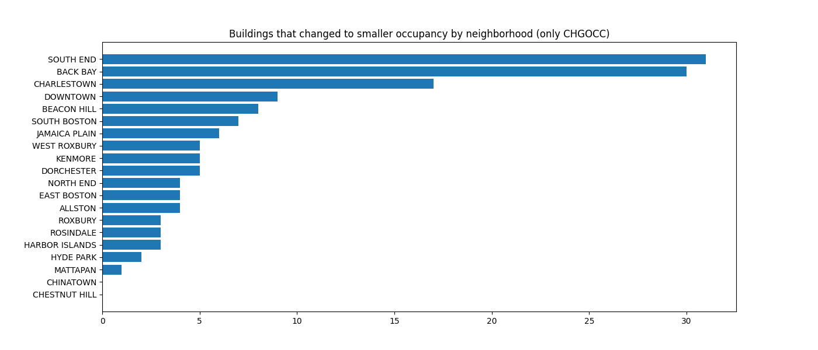
Buildings that changed to smaller occupancy by community
Unit lost happened the most in South End, followed by Back Bay and Charlestown

Slide 27
FUTURE PLANS
Extension Questions:
How does the rate of renovations in each neighborhood affect the change in available units from year to year? Comparing permits data to changes in available units(R1, R4)
What contributes to the large changes in housing units in areas like Hyde Park or the South End?
What neighborhoods have experienced the most significant reduction in available units due to the conversion of multi-unit properties into single-family residences by higher-income, and what factors contribute to this trend?

Slide 28
QUESTIONS?

